Slide 1
Hypotension Prediction Index
- The Emperors New ML Clothes
Simon Tilma Vistisen, vistisen@clin.au.dk
Aarhus University, Denmark

Slide 2
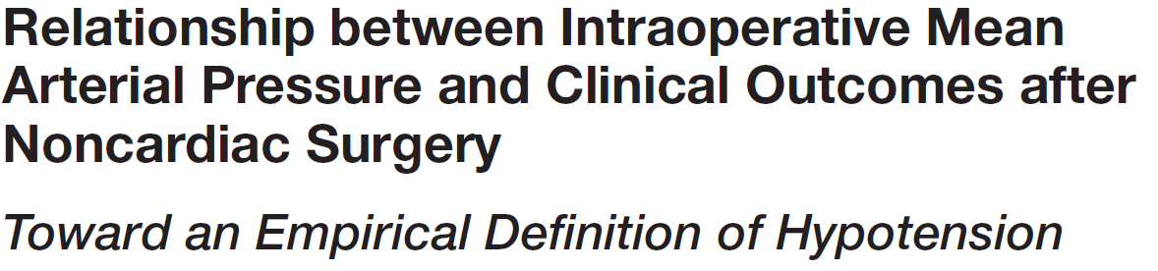

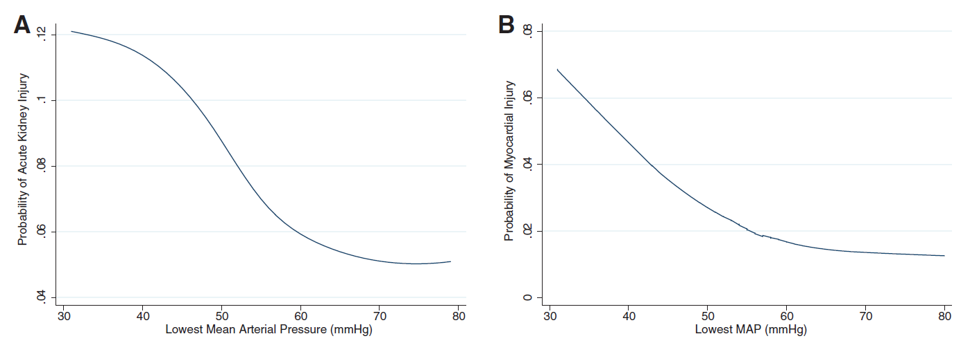
Why this Index?
Observational studies

Slide 3
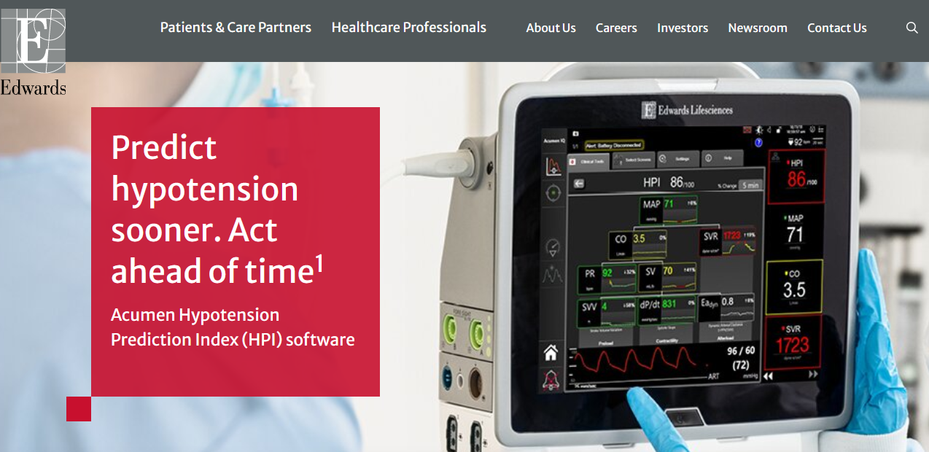
HPI – a commercial prediction algorithm

Slide 4
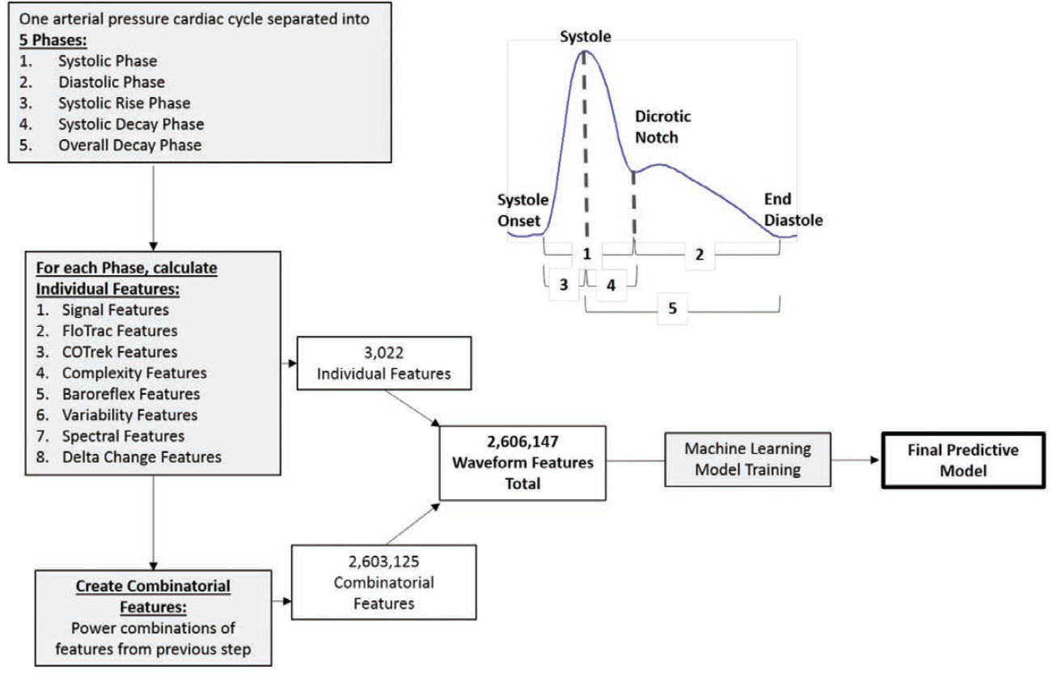
HPI – a commercial prediction algorithm
Final model:
Logistic regression of 23 features derived from the arterial waveform
Predicting MAP < 65 mmHg in 5-10-15 minutes

Slide 5
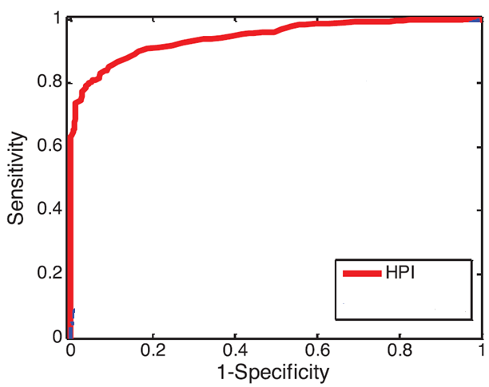
Results in index publication

Slide 6
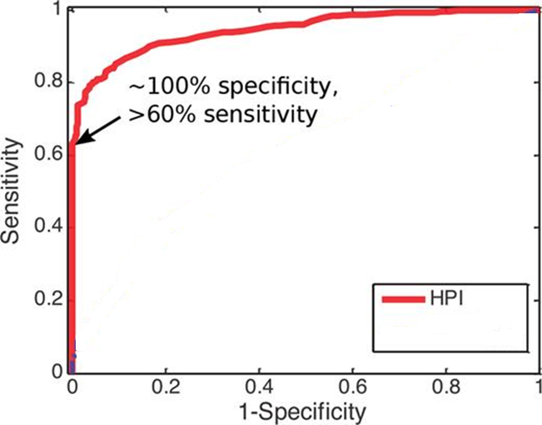
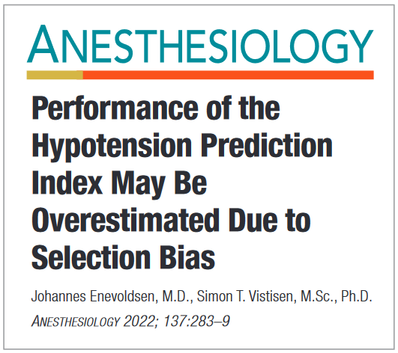

The “concern”
What would underlying data look like?

Slide 7
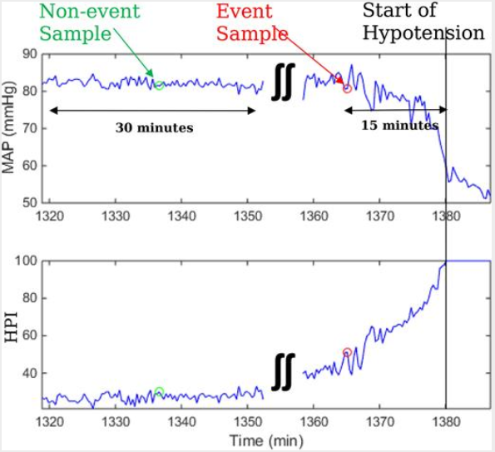
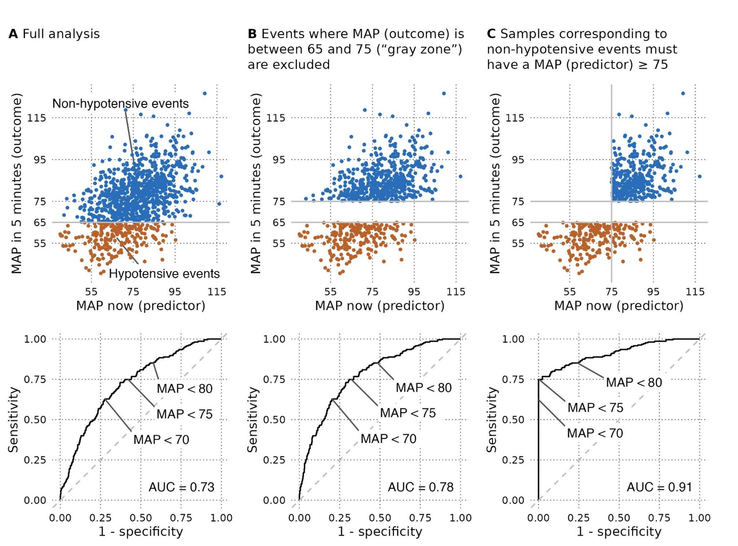
Selection bias – one feature is…

Slide 8
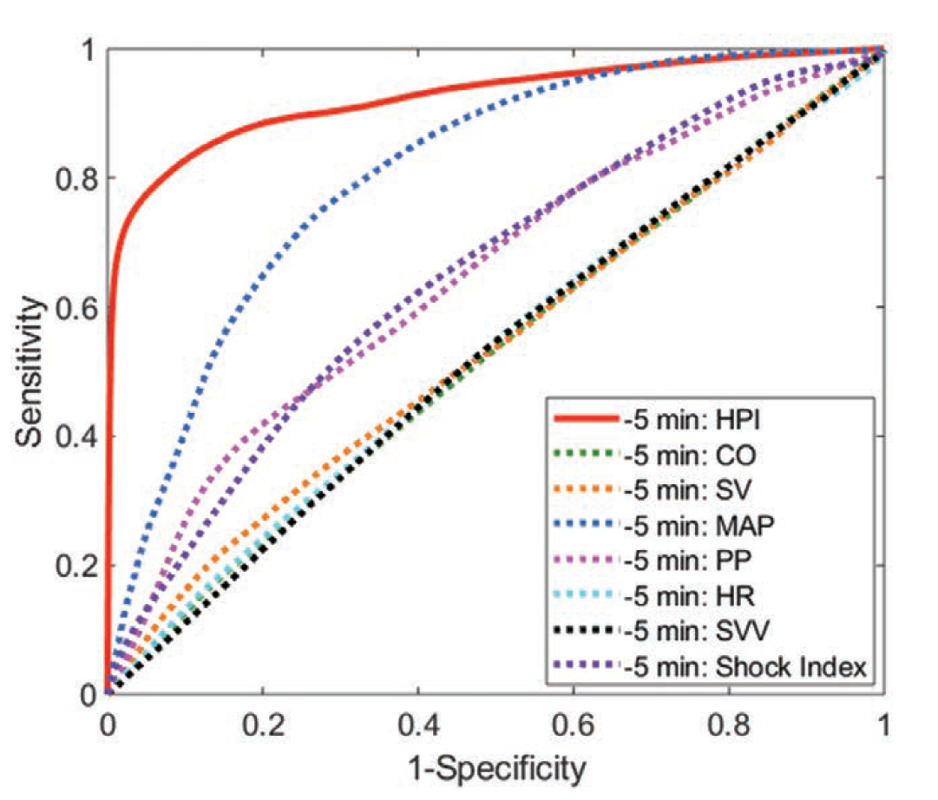
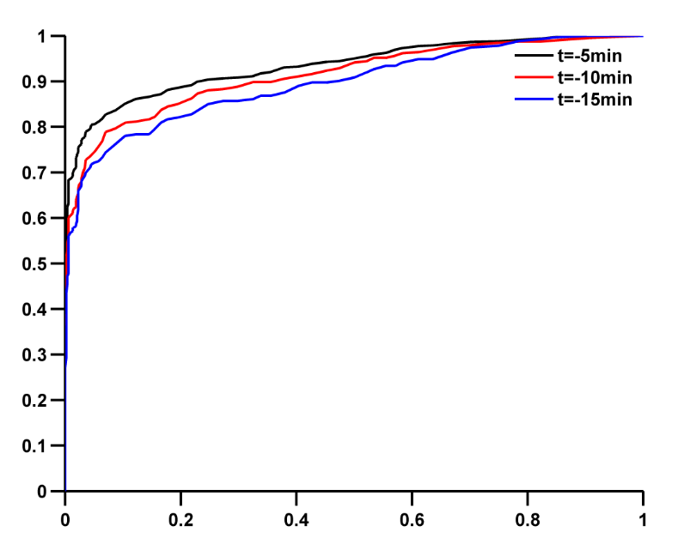
What do we get from this SAME flawed data selection?
Anesth Analg 2022:633-643.
Extreme specificities
Anesth Analg 2020;130:352–9
J Clin Monit Comput 2021:71-78
J Clin Monit Comput 2022:1325-1332

Slide 9
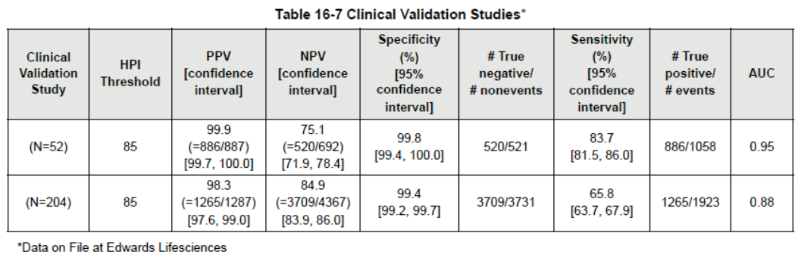
Two crucial questions emerge
How much did HPI learn from MAP? Are they just “the same”?
What is the predictive performance outside the selection bias fantasy world - HPI and MAP?
  In particular: The positive predictive value

Slide 10
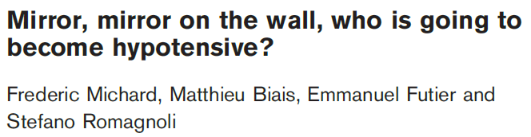
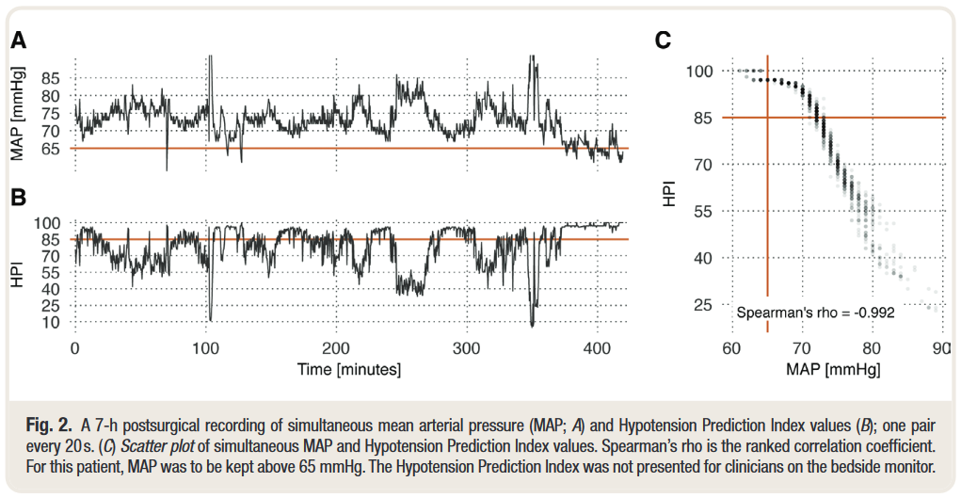
At the bedside:
Mirror effect – same prediction?

Slide 11

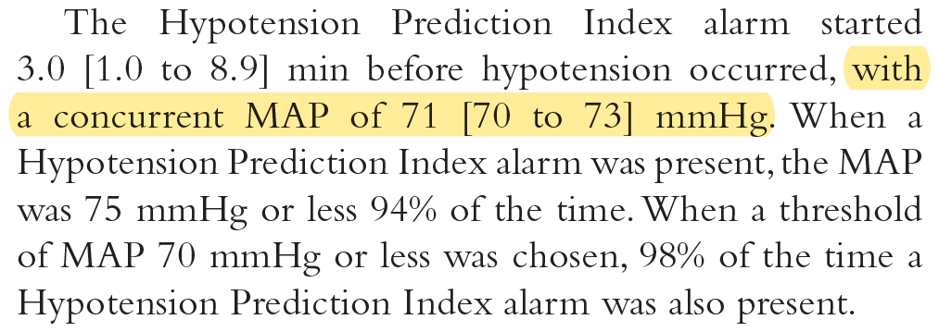
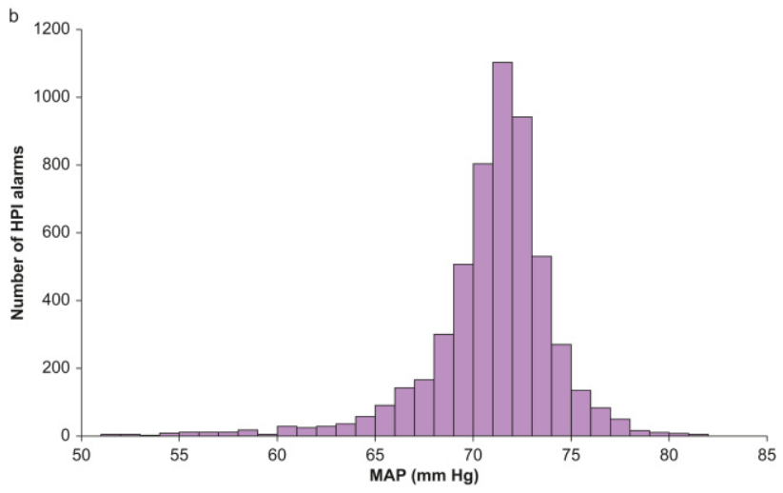
Scientific status – “resemblance”

Slide 12
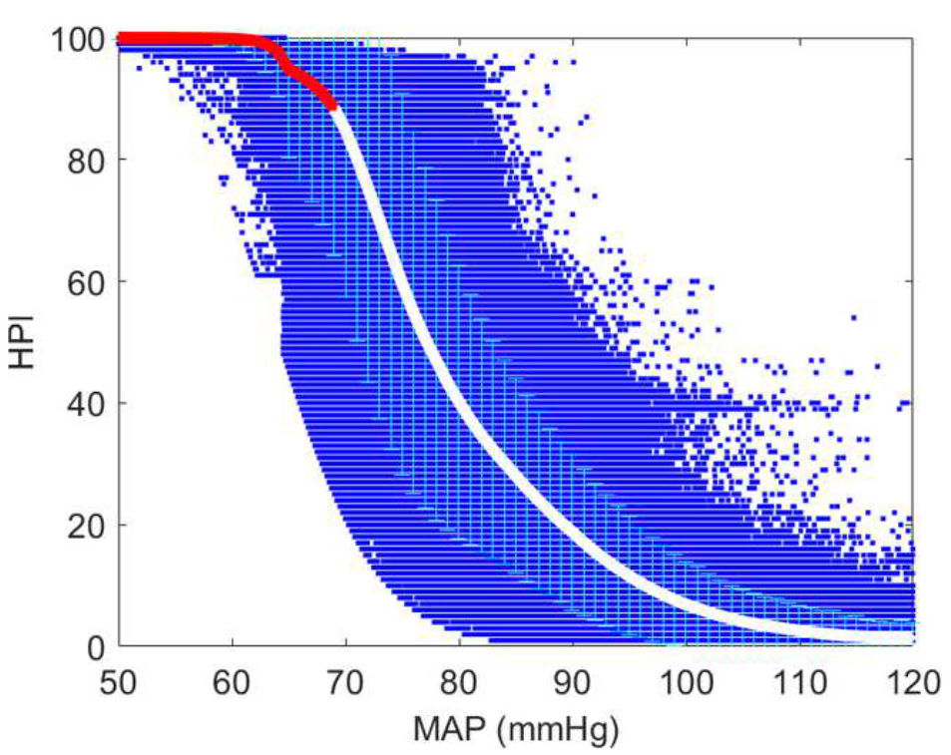
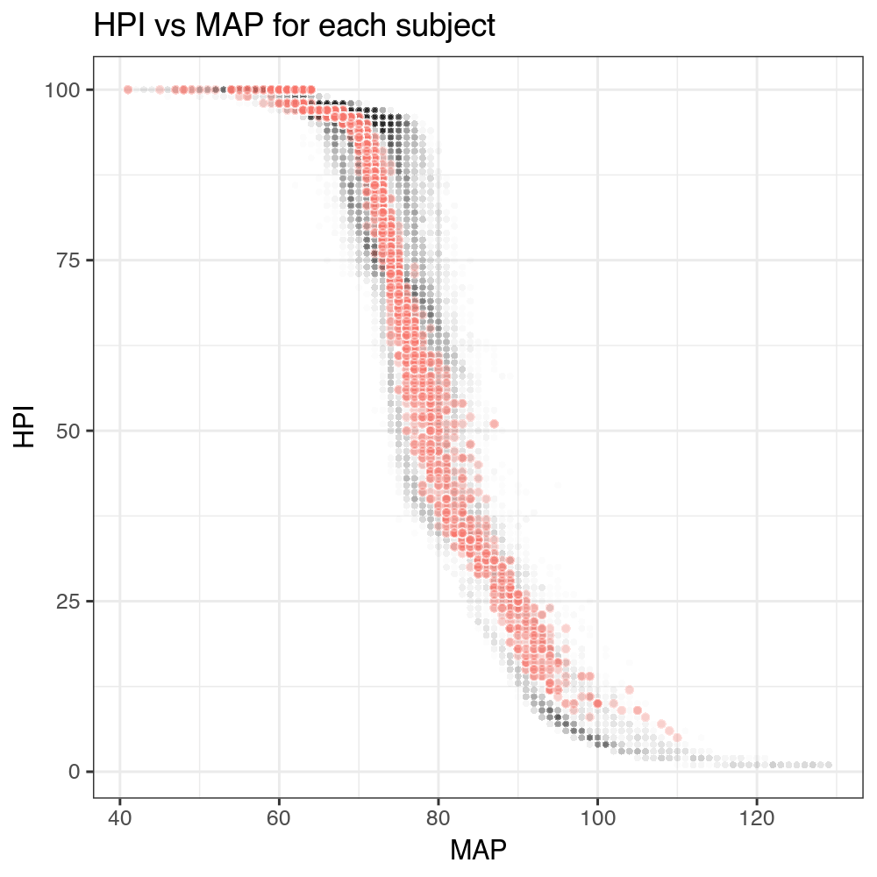
Correlation between HPI and MAP
Two studies from april 2024 (Anesthesiology)
Davies et al.
  R² = 0.77
Mulder et al.
  R² = 0.77
  Spearman rho = -0.97
    (intra-subject rho = -0.99)

Slide 13
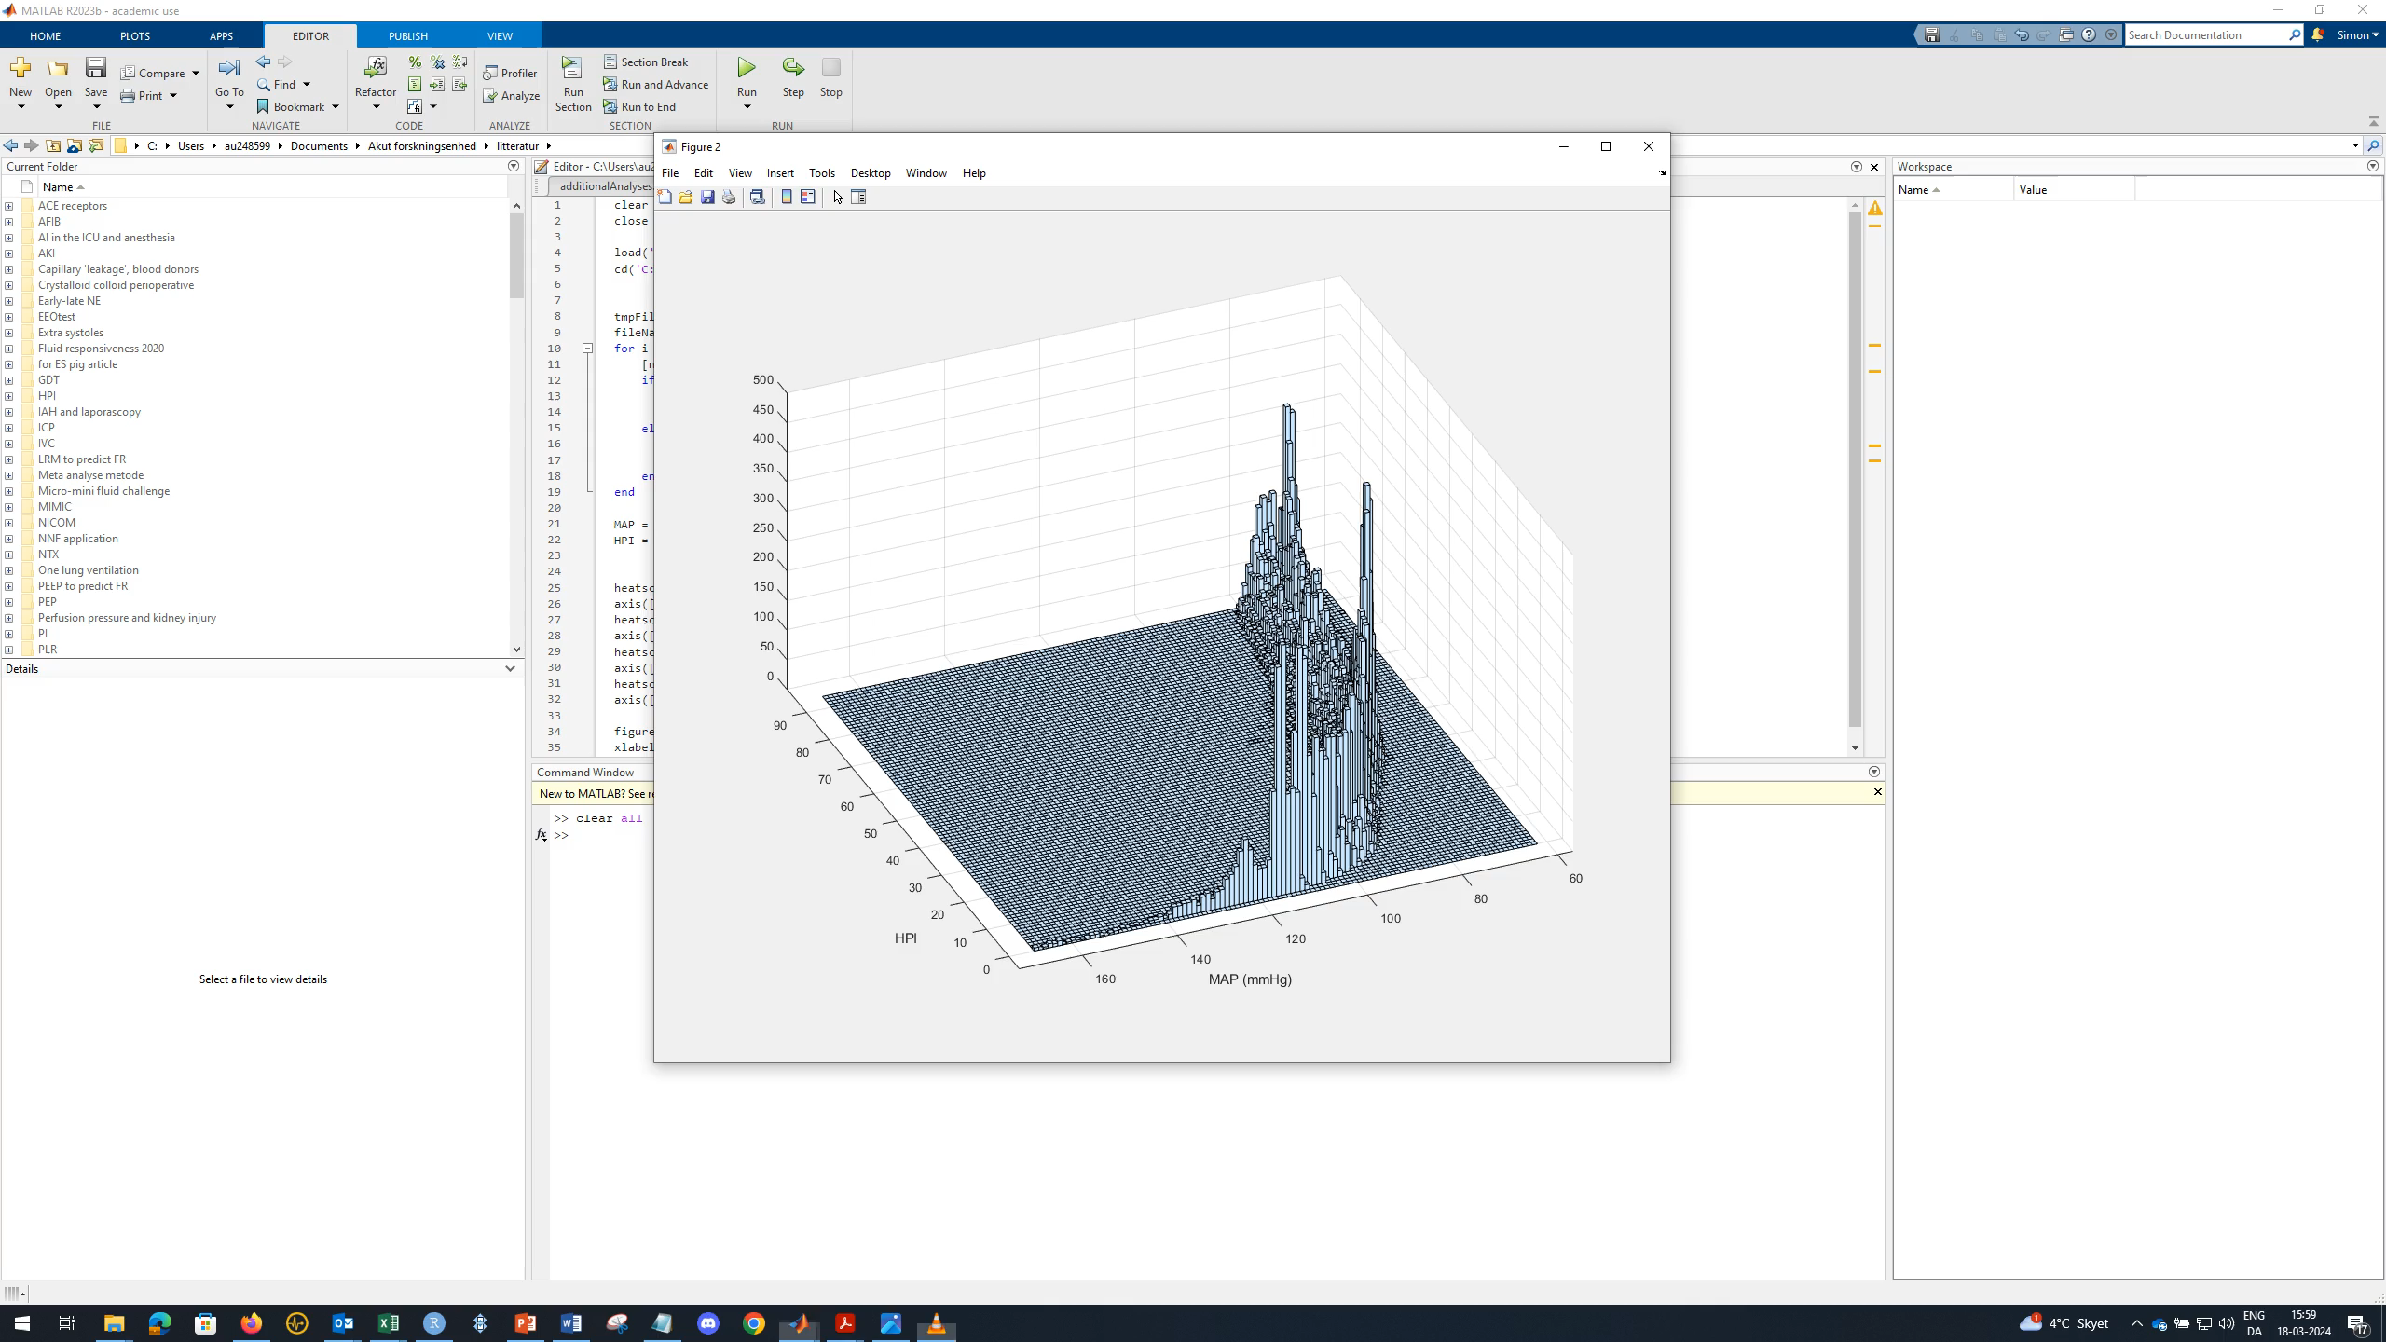

Slide 14
Scientific status – classification
One previous study’s ROC curves…
MAP faced another classification task
  The same selection bias was not present
This means that the figure is useless for any comparisons

Slide 15
The scientific problem:
Comparing A and C – apples and pears

Slide 16
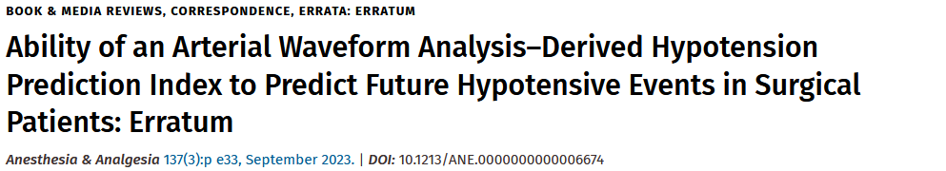
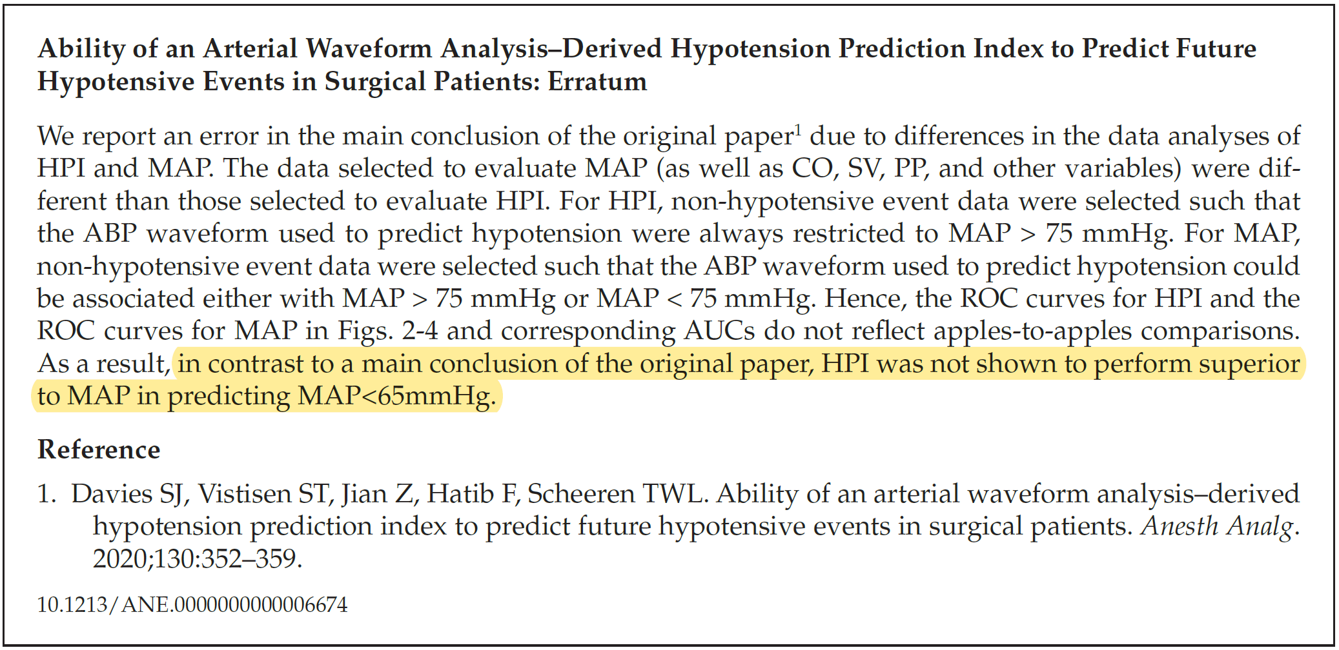
Erratum published

Slide 17
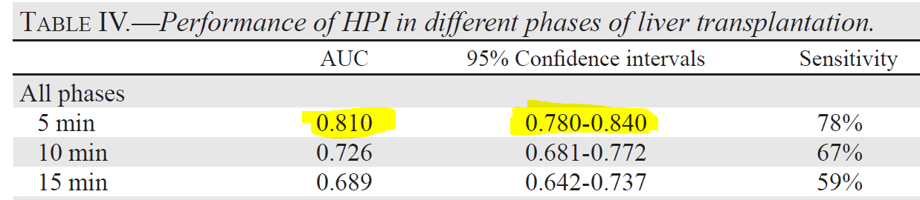
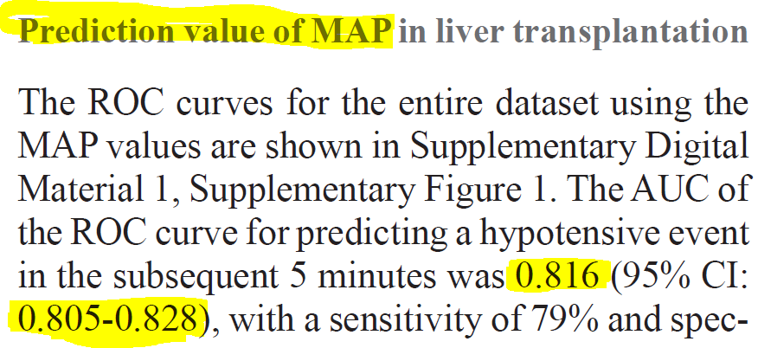
Scientific status - classification
Minerva Anestesiol 2023:387-395

Slide 18
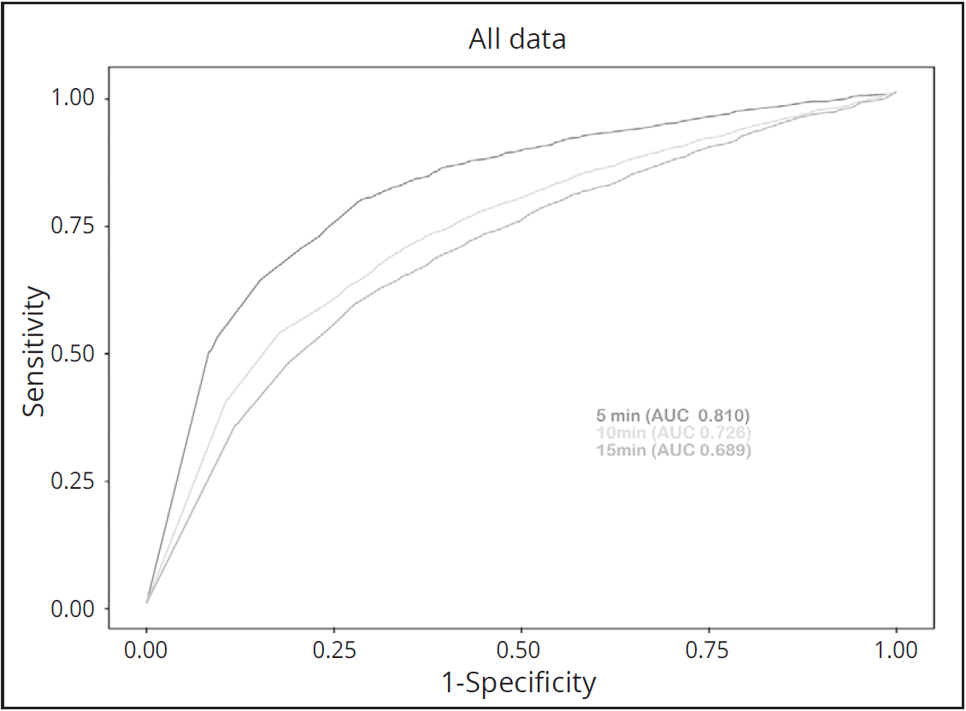
HPI

Slide 19
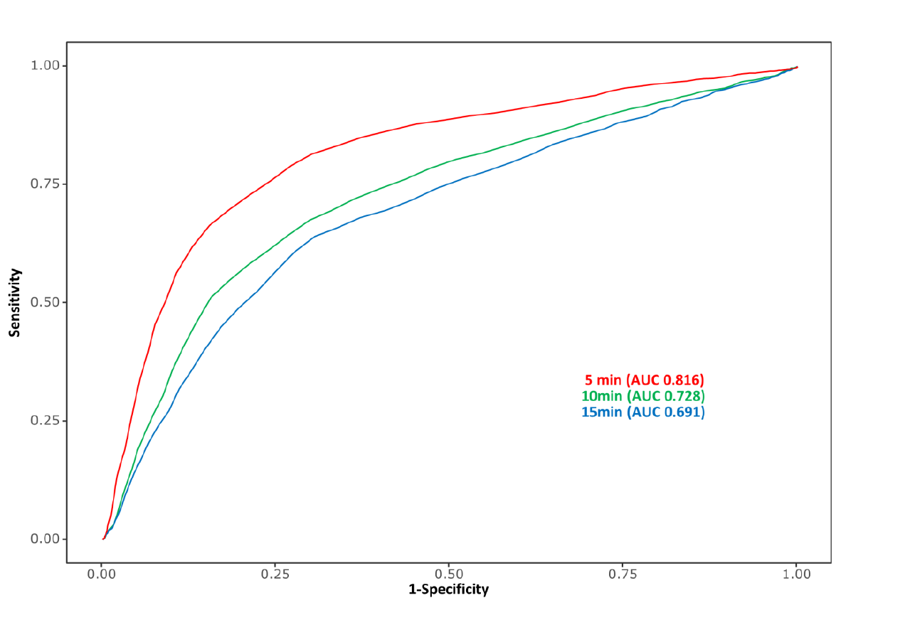
MAP

Slide 20
Two very recent studies published…
One by an independent group (Mulder et al.)
Another by the company and its researchers (Davies et al.)

Slide 21
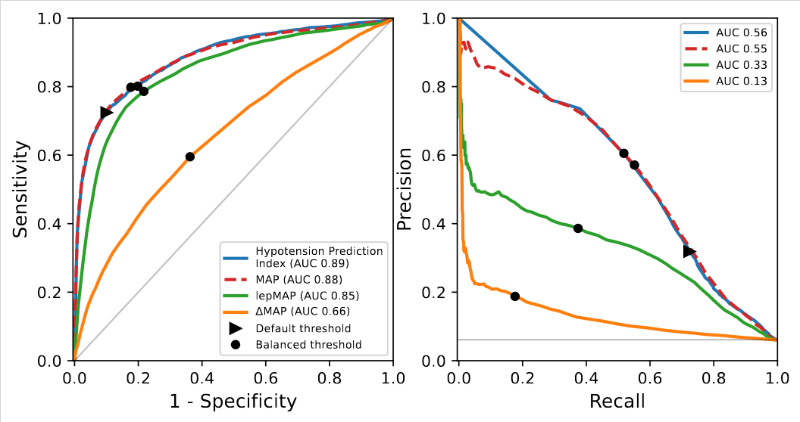
Recent study april 2024 (Mulder et al.)

Slide 22
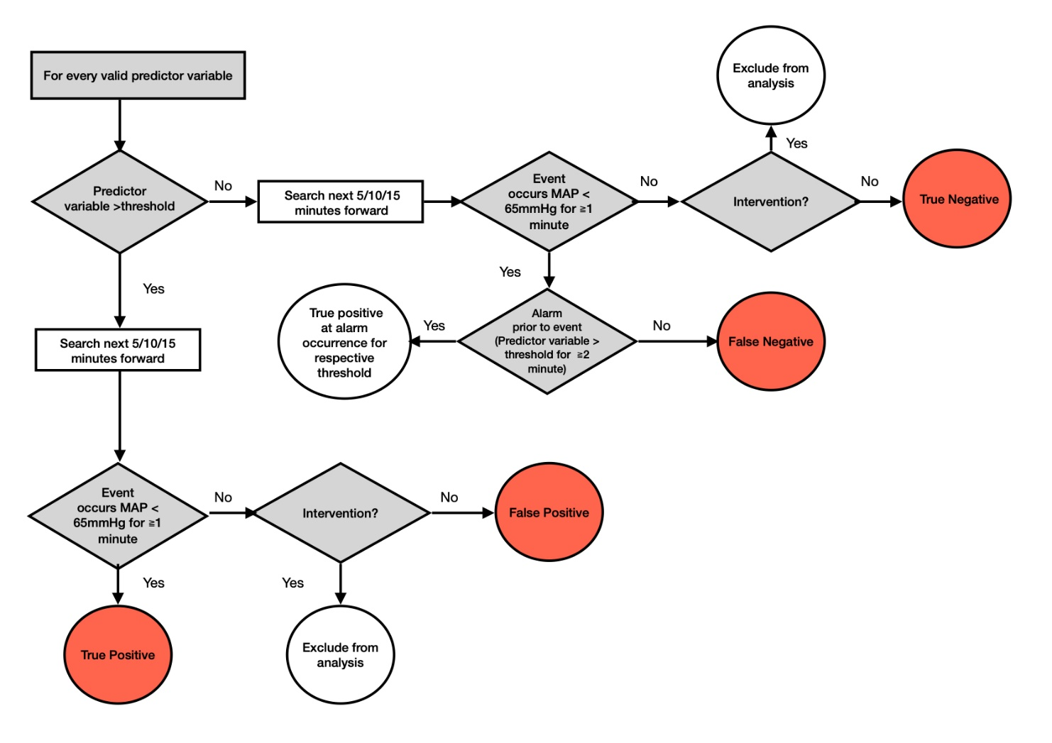
Recent study april 2024 (Davies et al.)

Slide 23
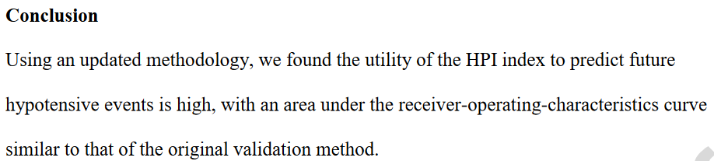
Still, it is applas-apples comparison:
AUCs | HPI | MAP
5 min | 0.923 | 0.932
10 min | 0.923 | 0.929
15 min | 0.926 | 0.932

Slide 24
The positive predictive value?
When the alarm goes off – how often is it trustworthy?
  Mulder: PPV is around 25-35%
Evaluating all data points:
  Both studies: PPV is approx. 30%
BY FAR, most alarms are false alarms

Slide 25
So…
HPI and MAP are extremely correlated
HPI’s positive predictive value is low
Performance of HPI almost identical to MAP prediction
Patients are overtreated (data not shown/presented)

Slide 26
Conclusions
HPI is worthless: NO EVIDENCE that it predicts better than MAP
RCTs may simply investigate the difference between these MAP-alarm treatment thresholds:
  65 mmHg
  ~ 70-73 mmHg
vistisen@clin.au.dk

