Slide 1
WHAT GAME ARE WE PLAYING AT?
Micaela Castiglioni
&
Carola Girotti
University of Milano-Bicocca, Italy

Slide 2
The current political-economic-institutional and sociocultural context
is shaping
a complex globalized society characterized by uncertainty and risk
ADULTS
often find themselves beset by fragility, anxieties and problems leading
(Bauman, 1999; Beck, 2000, Sennett, 1999)
(Bauman, 1999; Beck, 2000, Sennett, 1999)

Slide 3
DOMINANT NARRATIVES equate the
FLEXIBILITY and UNCERTAINTY with
CONTINUOUS CHANGE
NARRATIVE RHETORIC that is functional to the logic of the market and the consequent commercialization of all that belongs to “the human”

Slide 4
The DOMINANT PERFORMATIVE NARRATIVE
of the “CULTURE OF THE PRESENT MOMENT”
and the “RUSH CULTURE”
On the background
the unique and diverse little considerated narratives of
INDIVIDUAL ADULTS
each bearing specific NEEDS, ANXIETIES, FEARS, FRAGILITIES, etc.
TWO ALTERNATIVE WAYS OF NARRATING THE PRESENT?

Slide 5
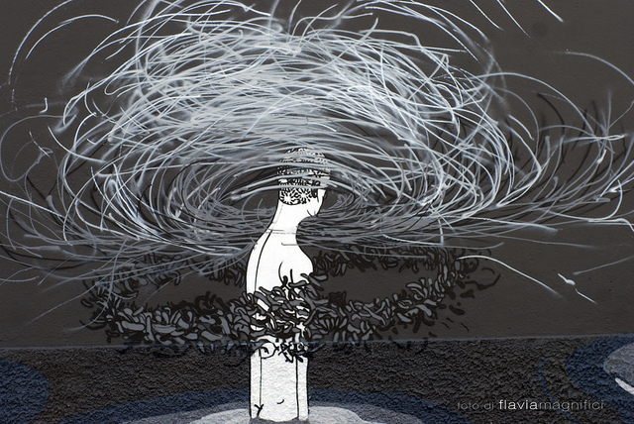
CONFUSED AND CONFUSING NARRATIVE
fragility can easily turn into varying degrees of vulnerability, potentially leading some adults to adopt
RISK BEHAVIOURS
EXPERIENCE OF THE GAME

Slide 6
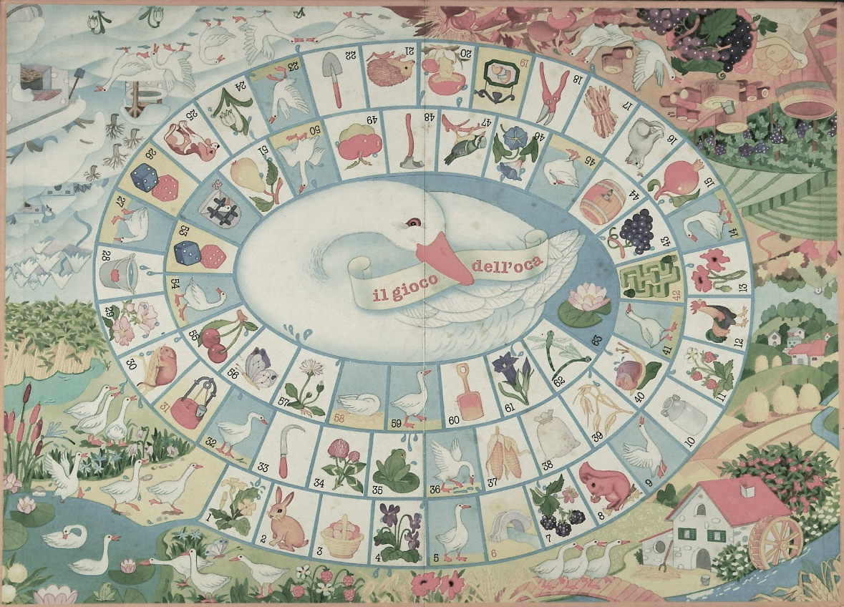
GAMES IN ADULTHOOD:
AN ACTIVITY IN CONTRAST WITH WORK;
AN EXPERIENCE THAT IS BOTH ENTERTAINING AND RELAXING;
INDIVIDUALS CAN ENGAGE IN AS THEY WANT;
FOR SOCIAL RATHER THAN FOR ECONOMIC GAIN.
(Carlevaro, 2002)

Slide 7
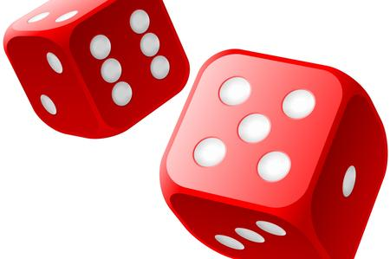
ALEA E AGON
Alea is a Latin word whose literal translation is dice: it describes games whose outcome does not depend on the skill of the player but exclusively on chance.
This category includes games that are highly passive in nature, in which competence has no bearing on the result: for example, roulette, lotteries and scratchcards.
Agon category, which require players to participate responsibly and draw on different kinds of ability, and whose categorical imperative is precisely that of not abandoning oneself to one’s fate. Agon demands patience, concentration, constant training and the subject’s will to determine.
(Caillois, 2013)

Slide 8
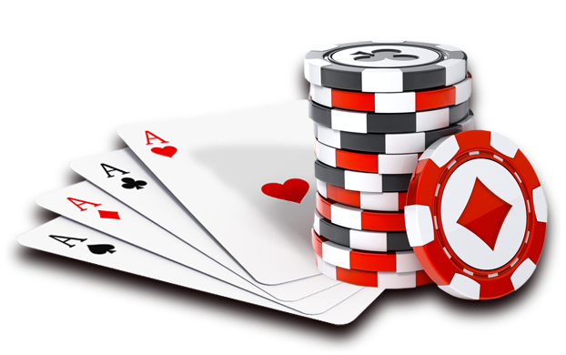
ALEA E AGON
There are games however in which Alea and Agon are both present, giving rise to a third category, in which the human player is both a passive subject waiting to know his or her fate and at the same time called to actively prepare, participate, and attempt to overcome difficulties
(Caillois, 2013)

Slide 9
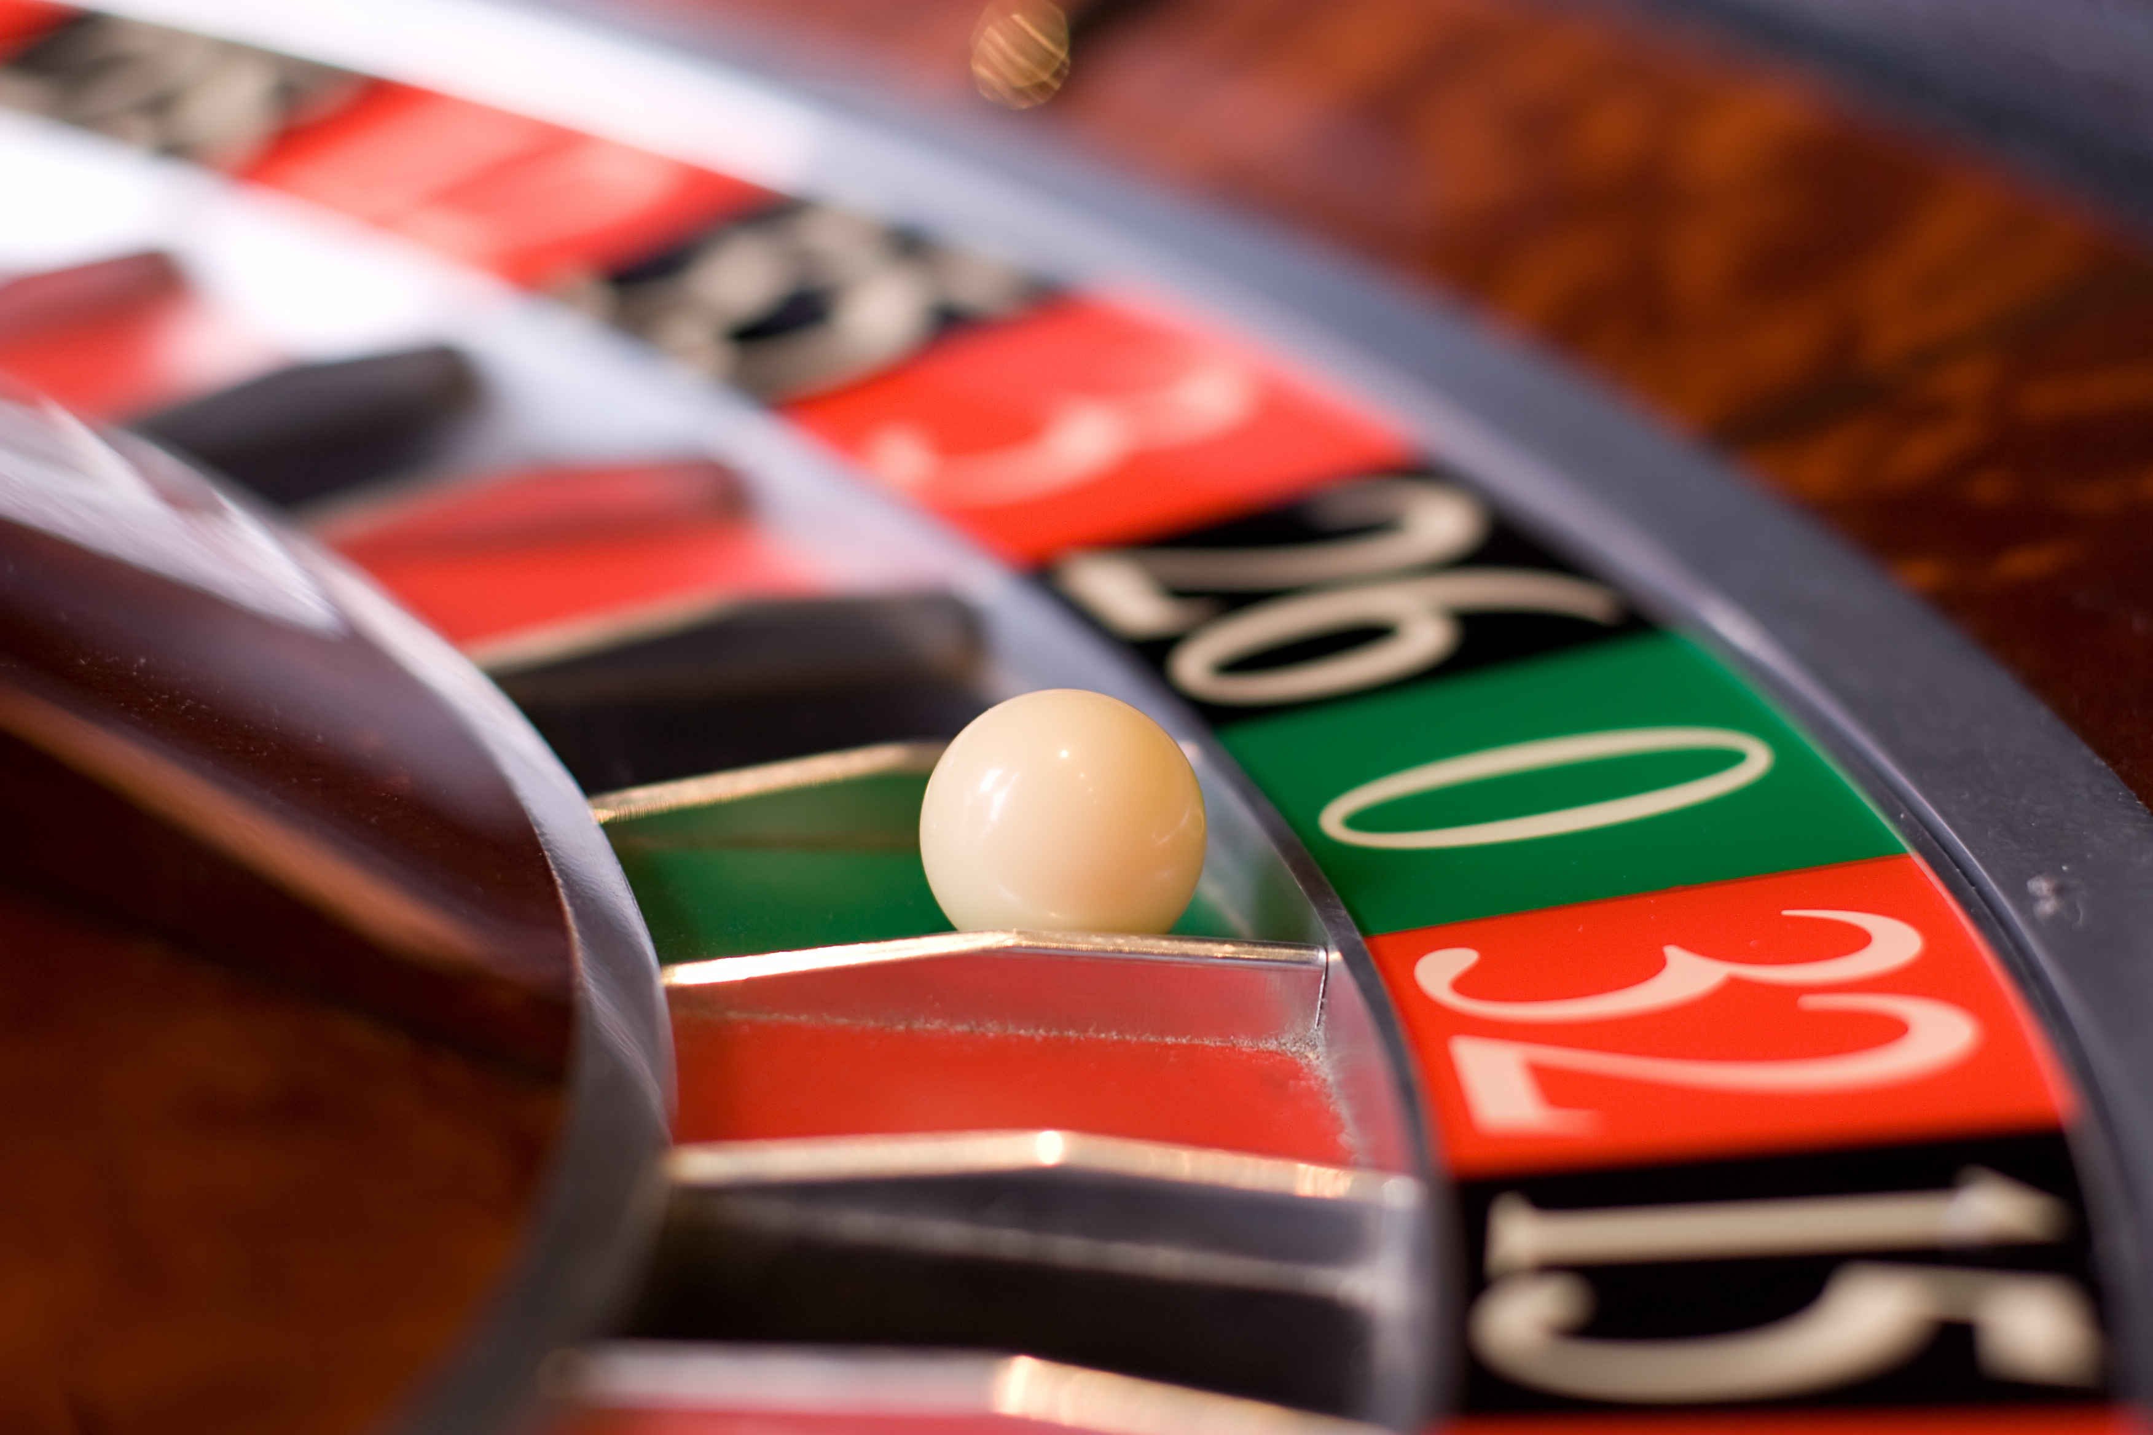
Another side to play, the dangerous side, that poses risks for adults who engage in it and can even become a form of illness: GAMBLING
GAMBLING ADDICTION

Slide 10
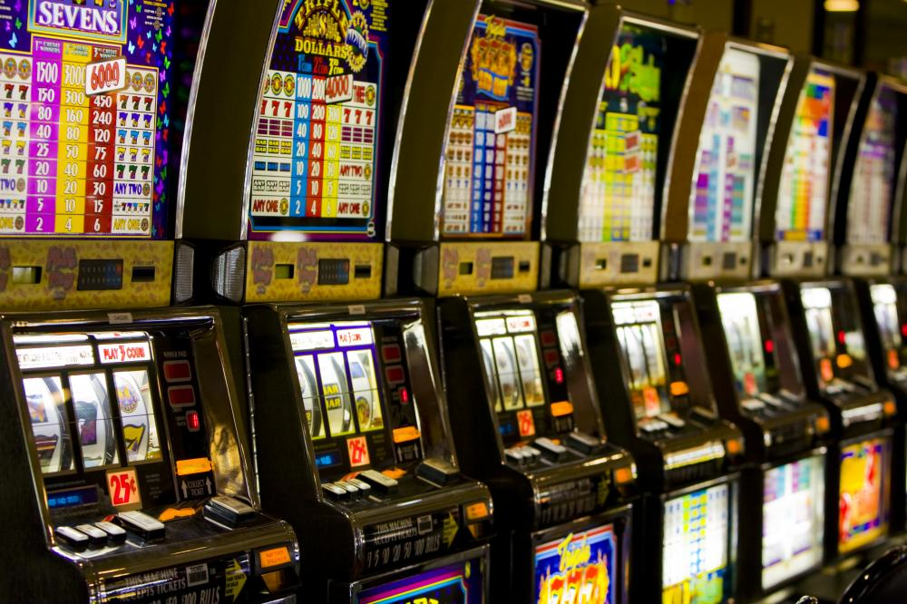
In periods of economic recession and depression, when consumption is slow and traditional economic sectors contract, the gambling market flourishes: governments anxious to boost tax revenue frequently contribute to this state of affairs by promoting gambling and thereby selling dreams to their most “hopeless” citizens
ILLUSION
OF EASY
WINNINGS
(Fiasco, 2001)

Slide 11
It is important that
COUNTER-NARRATIVE
be brought to the fore so that it may become one of the “DISCOURSES WE LIVE BY”
prompting ADULTS
to RE-TURN TO PLAYING GAMES
IN THE SENSE OF RE-DISCOVERING
THE RE-CREATIONAL AND POSITIVE FUNCTIONS OF PLAY

Slide 12
EDUCATIONAL NARRATIVE
IN CARE WITH AN EDUCATIONAL COMPONENT
In Italy…
SERT AND GIOCATORI ANONIMI (Gamblers Anonymous)
are two organizations that play a key role in educating adults to rediscover the positive aspects of playing games

Slide 13
QUESTIONNAIRE ADMINISTERED ANONYMOUSLY TO GAMBLERS

Slide 14
THANKS FOR THE ATTENTION!

