Slide 1
Writing A New Story
Susan Kay Mossman Riva
ESREA 25th Annual Conferene in Copenhagen, Denmark : ‘Discourses we live by’
(How) Do they benefit the world we live in?
March, 2017

Slide 2
Narrative Performance and Musicality
An adopted child’s archetypical search for her origins
Peter Gabriel’s ‘Book of Love’
Jung’s Red Book: Experentiel paths to higher knowing
Finding my voice

Slide 4
Love Letters
A letter to my birth mother
Facilitated communication
The ways of the heart
The Encyclical Letter Laudato SI’

Slide 5
Liminal Space: Between the Old Story and the New Story
Thomas Berry’s “The Dream of the Earth”
“Transmission: Passing on the Golden Pocket Watch” my autoethnographic work in progress
The ‘entre-nous’ in social poetics

Slide 6
Manumitting: Using Narrative as a Tool for Emancipation
Intertwined Time-Scales
The Era of Anthropocene
Individual and Collective Entanglement
Bio-social becomings

Slide 7
Incorporating the Epigenetic Paradigm
Writing to transform relations
Epiphany and awe as catalysts for transformation
Community writing groups
Healing conversations through authorship

Slide 8
Aspiring to a Culture of Care
“Journey of the Universe: The Unforlding of Life”
Kleinman’s call to actively respond to human suffering
A story where worldlings are invited to enter into earthship

Slide 9
Transmission: The Gifting Process
What we pass on to future generations
Bequething the good life
Kinship and lineage

Slide 10
Heartfelt Belonging Through Time
Autoethnographcic questing
Caregivers for our shared commons
How kinship and belonging in-form the future
The Golden Pocket Watch: a transitional object alluding to divine timing and being watched over
Shapeshifting in the ‘Divine Mileu’

Slide 11
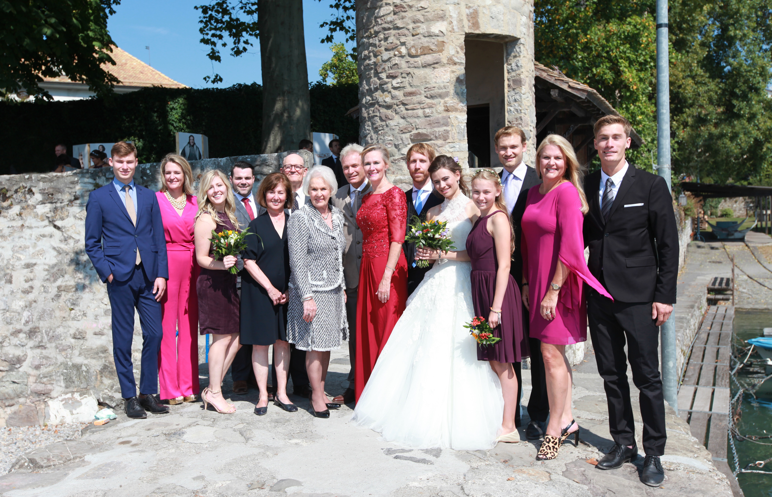
Celebrating Kinship and Belonging

